Slide 1
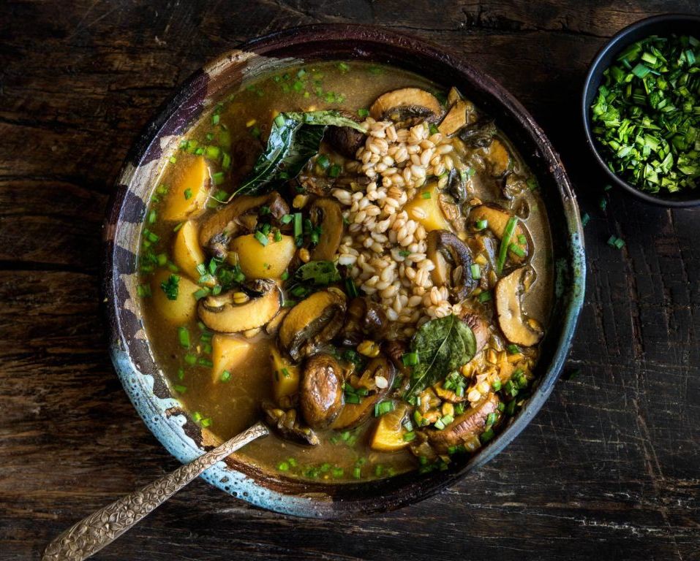
KaiaFIT
Cookbook

Slide 2
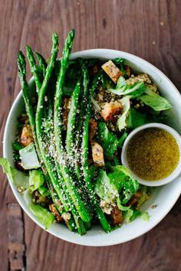
Welcome to Kaia BRIK, a program designed to help you get in the best shape of your life, mentally and physically. BRIK is a holistic program that focuses on strengthening your mind, body, and spirit while helping you develop and maintain healthy eating habits.
The Kaia Cookbook is chock-full of recipes that will keep you satisfied while fueling your performance. Paired with the Nutrition Guide and the Nutrition Plan, the Cookbook is designed to lead you through these six weeks with ease. Within, you will find a number of Kaia approved smoothies, entrees, appetizers, and even desserts.
Kaia is about finding what works for you – whether you follow the meal plan exactly, or simply use the Cookbook, Nutrition Guide and Nutrition Plan as templates for creating your own healthy snacks and meals! Kaia is all about finding what makes you feel your strongest!
Now is the time—let’s commit to FIT!

Slide 3
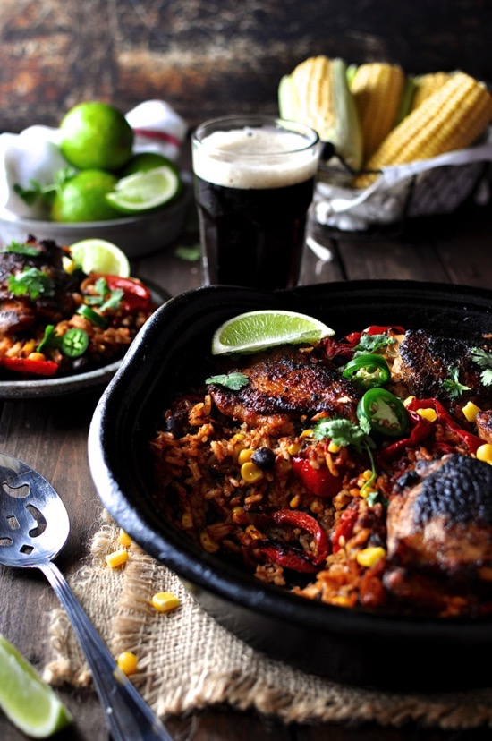
Nutrition Tips
Fall is here and it’s time to indulge in the warm, comforting and cozy foods of the season – and yes, we can still make it healthy! Here are some tips and tricks to keeping yourself fueled up and prepared for those fall workouts:
Stay Hydrated! – It’s easy to forget hydration during the colder months, when chilly weather makes us feel less thirsty, but our bodies need just as much water in winter as we did in the summer. Drink half of your body weight in ounces of water per day. If you’re exercising outside, warm your water slightly if you can – this will help keep you from getting chilled.
Eat Healthy Carbohydrates! – Cooler body temperatures combined with a drop in serotonin production (hello shorter days!) can increase your appetite and make your body crave carbohydrates. Don’t resist the urge – just make healthy choices. Sweet potatoes, parsnips and winter squash are delicious as soups or roasted in the oven. Replace mashed potatoes with a turnip puree or mashed rutabaga. Sprinkle fresh herbs over your root vegetables for an extra boost of vitamins and disease-fighting nutrients.
Cheat the Chill! – Eating stokes your body temperature (it’s called thermogenesis) and warm, filling soups and teas can help you fight cravings. Follow up a chilly workout with a steaming bowl of soup, or start your day with a toasty bowl of oatmeal. Spice up your dishes with pepper or cayenne, and indulge in as many Kaia Kocktails as you please! *All nutrition info is estimated per serving
CONTENTS
Smoothies & Juices…..Page 5
Breakfast……………...Page 31
Salads………………...Page 45
Soup……………….....Page 65
Entrees………………..Page 79
Sides & Sweets………Page 121
Chips, Dips…………..Page 130
& Dressings
Endurance Fuels……..Page 140
& Water Infusions
Quick Snacks……......Page 149

Slide 4
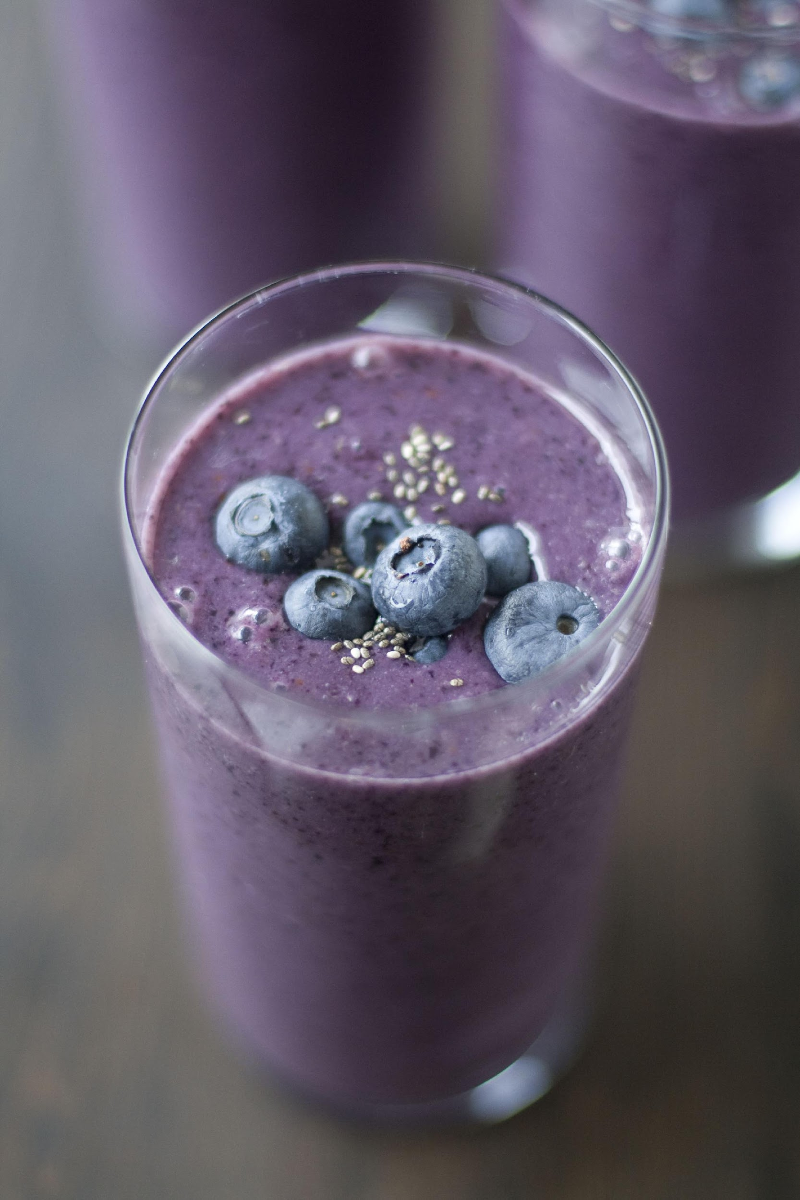
Smoothies & Juices
Blue Sky Smoothie
1 cup water
1 cup spinach
1 cup blueberries (frozen or fresh)
¼ cup blackberries
1 tbsp almond butter
½ lemon, juiced
Mix all ingredients in blender.
Calories: 191, Fiber: 6.3g, Sugar: 5.6g
Blushing for Blueberries
1 cup nut milk
2 cups water
1 cup frozen blueberries
4 almonds
1 cup kale
2 tbsp Chia seeds
1 tsp coriander and cinnamon
Top with 1 tbsp shredded coconut
Mix all ingredients in blender.
Calories: 120, Fiber: 5g, Sugar: 8g

Slide 5
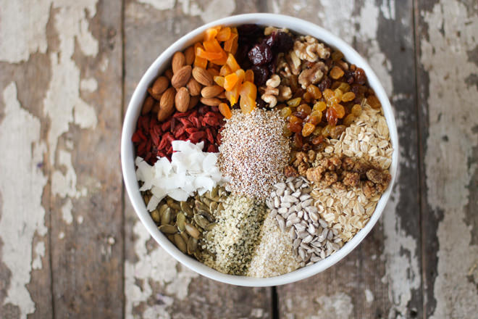
Breakfast
Kaia Strong Muesli
2 cups nut milk
1 tsp vanilla
1 tsp cinnamon
1 tsp ground ginger (optional)
1 tsp coconut oil
¼ cup sunflower seeds
¼ cup berries & (optional) goji berries
¼ cup ground flax or Chia seeds
¼ cup pumpkin seeds
Warm milk in a saucepan 2-3 mins.
Add vanilla, all spices, Stevia, and coconut oil.
Add remaining ingredients and heat for 2 mins. Serve and enjoy
Calories: 452, Fiber: 16g
Serves 2

